Slide 1
MeetUp App
Krithik, Alex, Aristos

Slide 2
Motivation & Problem Statement
Motivation
Our motivation came from trying to find time to get together and work on this project. Since we would verbally say when we were available, it was hard to try and find an overlap of free time from everyone’s schedule.
What’s a better way to solve this problem other than by building an application that can visually show us when everyone is free!
Problem Statement
The problem that we are trying to solve is the frustrations and issues that come up when teams are trying to find time to meet.
Sometimes people are only available for 1 hour windows, that are scattered around the day.
With this application, the goal is for everyone to mark their availability, making it easy to see when is the best time to meet.

Slide 3
Background information on Technologies
NodeJS
A runtime environment that runs JavaScript on a Machine (in our case a VM) built on Chrome V8’s JavaScript Engine.
Using NodeJS as a server side component.
MySQL
To handle storing and retrieving data that was given by the user.
React
Open source front end JavaScript library for building UI based on UI components.
We plan to use React to develop the front end for the client side application.
Containers/Docker
To create a container for the MySQL server and NodeJS
Virtual Machines
We are using both QEMU and VirtualBox to deploy the workflow of the project

Slide 4
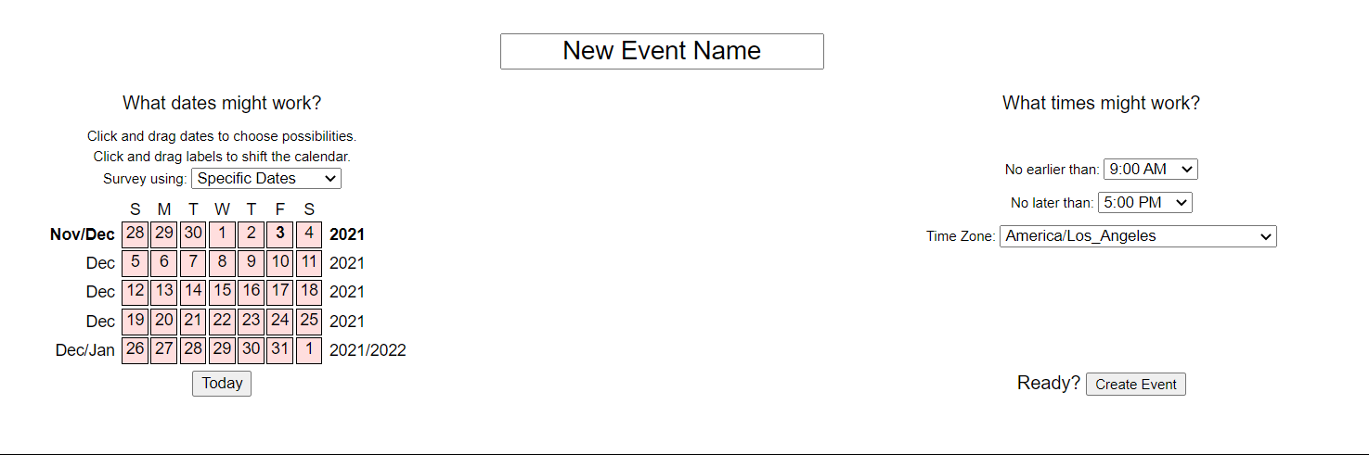
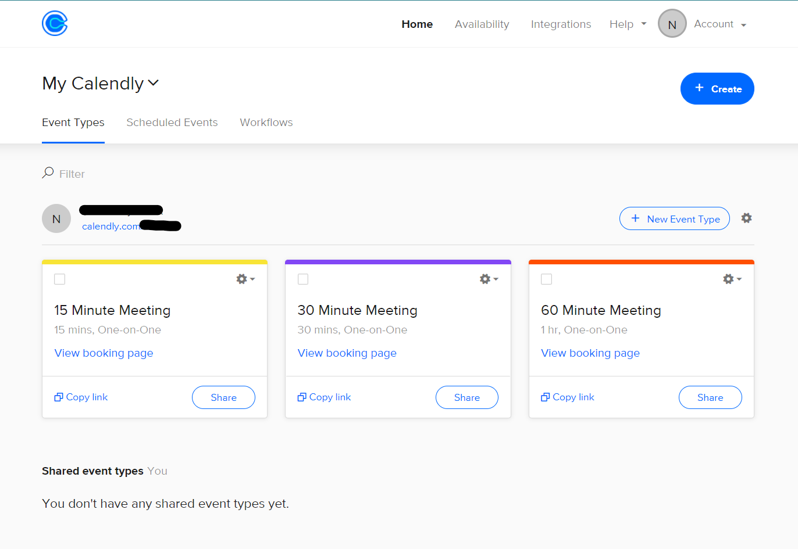
Related work
When2Meet
This site allows users to specify days they would like to meet.
Although it gets the job done, we wanted to be able to make one ourselves that not only looks better, but also teaches us how applications like these are built.
Calendly
Similarly, Calendly aims to avoid back and forth emails about when is a good time to meet.

Slide 5
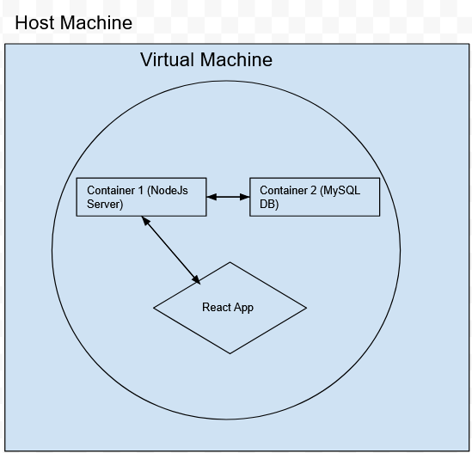
System Architecture
A VM running mySQL and NodeJS docker containers.
The VM would house the docker containers and enable communication using virtual network build using docker.
Notes:
Aristos:
-Frontend Web App(React), Server, and DB (SQL)
Containerized SQL

Slide 6
The Architecture of our app is build entirely inside a VM, which encapsulated all the necessary resources inside it.
There are going to be 2 docker containers inside this [the VM]
MySQl (database) - Containerized to make the database portable
Node (NodeJS server) - Containerized to keep the node-modules unique to the project
The communication between these 2 [containers] is established by using the user-defined network, enabled by docker network service, to which both are attached.
As an effort to make things light-weight, theoretically speaking, we pre-build the react application which is copied onto the Node container
Cloud Architecture

Slide 7
Software Architecture
Base system
We will be running all our applications inside a VM.
Communication of components
Since the communication happens between the Node and the MySQL containers, we created a virtual bridge network and connected both of them to it
The port forwarding for the VM, so we could use the react app, is done on the host machine from TCP -> TCP (port 3000 is mapped to VM’s 4000 port)
We built:
Front end Application (using React)
Server Side application (server.js) to accept and receive requests
Setup MySQL Database with custom image built on mysql image (portable image)
Already Available components:
MySQL Base Image Container
Node Base Image Container
Notes:
Aristos:
Port Forwarding VM 4000, 4000.

Slide 8
Outcomes of the Project
The goal of this project was to use Cloud Computing technologies to make our own rendition of a scheduling application.
We are building up a containerized database and application, so that it could be portable and the application itself could be migrated and implemented on any cloud systems
Notes:
Aristos

Slide 9
Possible Future Work
This application could also be used to schedule other activities. Although it primarily is used to show time that is available, this can be used individually as an agenda planner.
A reminder application - On top of blocking out time for specific projects, it can be used to send reminders to users
Change the structure of the application to run on a kubernetes cluster, with each component (React App, MySQL Database, and NodeJS server) running on their own container.

Slide 10
Demo-Time!

Slide 11
Questions?

